Slide 1

3D structure of the nucleon in the momentum space and the Electron-Ion Collider

Slide 2
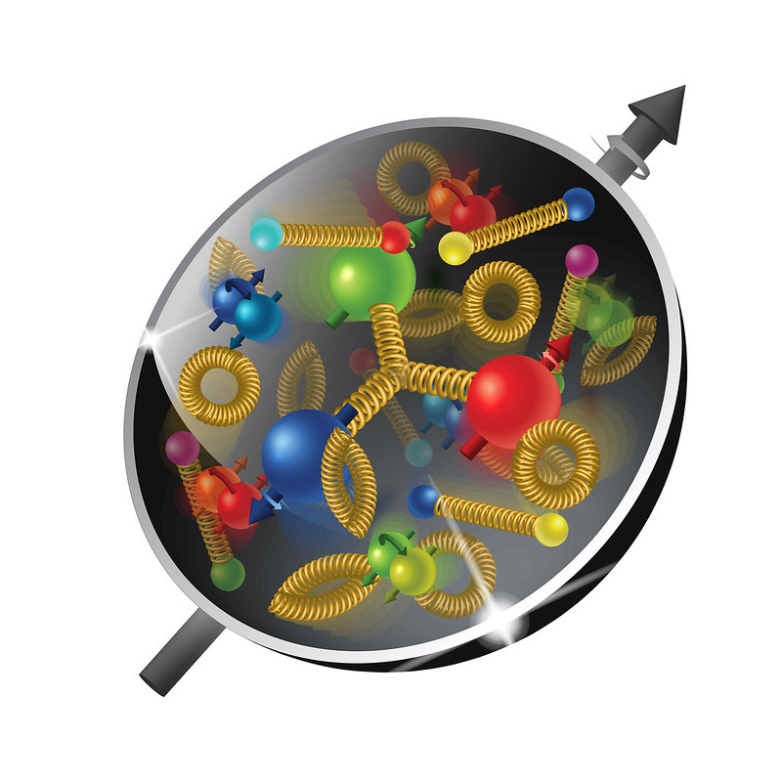
The plan
Lecture I:
Structure of the nucleon
Transverse Momentum Dependent distributions (TMDs)
Semi Inclusive Deep Inelastic Scattering (SIDIS)
Calculations of SIDIS structure functions in google colab
Lecture II:
Solution of TMD evolution equations
Collins-Soper-Sterman (CSS) formalism
Lecture III: Giuseppe Bozzi
Phenomenology of unpolarized TMDs

Slide 3
SIVERS function
Sign change
No sign change
2312.17379

Slide 4
Semi inclusive deep inelastic scattering

Slide 5
Semi inclusive deep inelastic scattering

Slide 6
Semi inclusive deep inelastic scattering

Slide 7
Semi inclusive deep inelastic scattering

Slide 8
Tmd evolution equations
Differential equations, diagonal in the flavor space. RHS can be expanded in perturbative series.
TMD anomalous dimension
Collins-Soper kernel is specific for TMDs
Cusp anomalous dimension
= Collins-Soper parameter
= UV renormalization scale

Slide 9
CSS solution of evolution equations
Collins-Soper-Sterman (CSS) organization of the solution of TMD evolution equations for the Drell-Yan cross section:
From https://arxiv.org/pdf/1412.3820

